Slide 1


Paulo Henrique Pereira da Cunha
April 2025

Slide 2

Outline
Executive Summary
Introduction
Methodology
Results
Insights drawn from EDA
Launch Sites Proximities Analysis
Build a Dashboard with Plotly Dash
Predictive Analysis (Classification)
Conclusions
Appendix

Slide 3
Executive Summary
This project explores whether it is possible to accurately predict the landing success of SpaceX’s Falcon 9 first stage using historical mission data. Successful landings significantly reduce launch costs by enabling rocket reuse, which is a critical factor in modern aerospace economics.
The analysis covers the full data science workflow, from data acquisition to machine learning, uncovering patterns and developing predictive insights. Visualizations and interactive dashboards offer both technical and intuitive understanding of the factors affecting landing outcomes.
The final model, a Decision Tree Classifier, achieved a test accuracy of 90,4%, offering the best balance between performance and interpretability. Key drivers of success include payload mass, launch site, orbit type, and hardware reuse history.
These findings not only validate the potential of machine learning in aerospace operations, but also provide a framework that can be adapted to other launch systems or mission planning scenarios.

Slide 4
Introduction
Project Goal: To predict Falcon 9 first stage landing outcomes using historical SpaceX data.
Research Questions:
What are the key factors influencing landing success?
How accurate can a machine learning model be in predicting landings?
Can interactive analytics improve understanding of launch patterns?
Context: Successful landings reduce costs drastically. Understanding what drives them is of major business interest.

Slide 5

Section 1

Slide 6
Methodology
Data Sources: SpaceX REST API (launches, rockets, payloads, launchpads) and Wikipedia (web scraping)
Data Preparation: Cleaning, merging, feature engineering (block version, reuse count), label creation
Exploratory Analysis: Visualizations (Seaborn, Matplotlib) and SQL queries to explore launch outcomes
Interactive Analytics: Folium maps (site markers, outcome colors, proximities) and Plotly Dash dashboard
Predictive Modeling: Classification with Logistic Regression, Decision Tree, SVM, KNN; hyperparameter tuning with GridSearchCV; evaluation with accuracy and confusion matrix

Slide 7
Data Collection
API (SpaceX)
Accessed endpoints for launches, rockets, payloads, cores, and launchpads using requests.get(); converted JSON responses into DataFrames with json_normalize().
Web Scraping (Wikipedia)
Retrieved Falcon 9 launch history table using BeautifulSoup; parsed HTML elements, removed annotations and special characters, and structured data with Pandas.
Data Parsing
Extracted nested attributes like payload mass, orbit type, landing success, booster version, and reuse count using custom Python functions.
Data Integration
Merged API and scraped datasets; standardized column names and data formats; removed duplicates and inconsistencies to create a clean master dataset.

Slide 8
Data Collection – SpaceX API
Accessed historical launch data via SpaceX REST API
Performed multiple GET requests using Python's requests library
Used custom helper functions to retrieve and extract nested information (e.g., booster, payload, cores)
Normalized JSON responses with pandas.json_normalize() to create structured DataFrames
Created master dataset with key fields: Flight Number, Payload Mass, Orbit, Reuse, Block, Launch Site, Landing Outcome
GitHub URL: https://github.com/paulohenriquecunha/FinalProjectDataScience/blob/main/jupyter-labs-spacex-data-collection-api.ipynb
REST API Call (requests.get)
↓
JSON Response (raw)
↓
Normalization (json_normalize)
↓
DataFrames per Entity
(launches, rockets, payloads, cores)
↓
Field Extraction (custom functions)
↓
Final Structured Dataset

Slide 9
Data Collection - Scraping
Extracted Falcon 9 and Falcon Heavy launch records from Wikipedia
Targeted HTML tables using requests.get() and BeautifulSoup
Parsed column headers and row values with custom functions (extract_column_from_header, booster_version, etc.)
Cleaned and converted scraped HTML tables into structured Pandas DataFrame
Used unicodedata and re to normalize values (e.g., payload mass in kg)
GitHub URL: https://github.com/paulohenriquecunha/FinalProjectDataScience/blob/main/jupyter-labs-webscraping.ipynb
Wikipedia URL (Static HTML Snapshot)
↓
HTTP Request (requests.get)
↓
Parse HTML Table (BeautifulSoup)
↓
Extract Columns & Rows (custom functions)
↓
Clean & Normalize Values (unicodedata, re)
↓
Convert to Structured DataFrame (pandas)

Slide 10
Data Wrangling
Merged datasets from API and web scraping to create a unified structure
Removed irrelevant columns and duplicated entriesHandled missing values (e.g., LandingPad, PayloadMass, Outcome)
Engineered new features: → Class (landing success: 1 or 0) → Block, ReusedCount, Orbit encoding
Converted categorical values into numerical format for modeling
Verified data types and cleaned inconsistencies across columns
GitHub URL: https://github.com/paulohenriquecunha/FinalProjectDataScience/blob/main/labs-jupyter-spacex-Data%20wrangling.ipynb
API + Scraped Datasets
↓
Merge & Align Columns
↓
Drop Duplicates & Clean Nulls
↓
Feature Engineering (Class, Reuse, Orbit)
↓
Convert Categorical to Numerical
↓
Final Clean Dataset for EDA & ML

Slide 11
EDA with Data Visualization
Flight Number vs. Payload Mass (with Class) → Scatter plot to observe patterns over time and relation with payload size. → Shows trend of higher success rates in later flights and lighter payloads.
Flight Number vs. Launch Site (with Class) → Strip plot to assess performance by launch site over time. → Reveals which sites achieved more successful landings.
Payload Mass vs. Orbit (with Class) → Box plot to compare landing success across orbit types and payload weights. → Highlights risky orbits and their relation to heavier loads.
Orbit vs. Outcome Count → Bar plot to evaluate which orbit types are associated with success/failure. → Useful to identify operational challenges by mission type.

Slide 12
EDA with SQL
Count of Total Missions per Launch Site → Identified the most frequently used sites
Average Payload Mass by Orbit Type → Highlighted orbits with heavier vs. lighter payloads
Most Frequent Booster Version → Revealed which hardware models were used most often
Earliest Successful Landing by Site → Helped map timeline of reusable rocket success
Success vs. Failure Counts by Outcome Type → Summarized overall landing performance
Sum of Payload Mass by Booster Version → Quantified delivery capacity over time
GitHub URL: https://github.com/paulohenriquecunha/FinalProjectDataScience/blob/main/jupyter-labs-eda-sql-coursera_sqllite.ipynb

Slide 13
Build an Interactive Map with Folium
Launch Site Markers (folium.Marker) → Marked geographic positions of each launch site → Added labels with site names for easy identification
Success/Failure Circles (folium.Circle) → Represented individual launches by outcome → Color-coded for visual distinction (success vs. failure)
Proximity Lines (folium.PolyLine) → Connected launch sites to nearby features (highways, coastlines, railways) → Helped evaluate logistical and geographical influences on launch outcomes
Map Layers and Zoom Control → Enabled dynamic interaction with specific sites and regions → Provided intuitive spatial understanding of launch distribution
GitHub URL: https://github.com/paulohenriquecunha/FinalProjectDataScience/blob/main/lab_jupyter_launch_site_location.ipynb

Slide 14
Build a Dashboard with Plotly Dash
Pie Chart – Total Success Launches by Site → Visualizes proportion of successful launches per site → Helps compare site performance at a glance
Scatter Plot – Payload Mass vs. Launch Success → Displays correlation between payload size and mission outcome → Points colored by booster version category to enrich insight
Dropdown Filter – Launch Site Selector → Enables selection of individual sites or all sites → Allows dynamic filtering of both plots
Payload Range Slider → Interactive range selector for payload mass → Refines scatter plot to highlight mass-related trends
GitHub URL: https://github.com/paulohenriquecunha/FinalProjectDataScience/blob/main/spacex-dash-app.py
Why These Elements Were Added:
To explore key success factors interactively
To compare sites, payloads, and hardware versions visually
To enhance usability for both analysts and stakeholders
To make insights accessible without running any code

Slide 15
Predictive Analysis (Classification)
Created a classification pipeline to predict Falcon 9 first stage landing success
Selected features: PayloadMass, Orbit, FlightNumber, Block, ReusedCount, etc.
Split data into training and test sets (80/20)
Applied and compared models:→ Logistic Regression→ Decision Tree→ K-Nearest Neighbors→ Support Vector Machine (SVM)
Used GridSearchCV for hyperparameter tuning
Evaluated models using accuracy score and confusion matrix
Predictive Modeling – Best Model: Decision Tree (90.4%)
GitHub URL: https://github.com/paulohenriquecunha/FinalProjectDataScience/blob/main/SpaceX_Machine%20Learning%20Prediction_Part_5.ipynb
Raw Dataset
↓
Data Cleaning & Feature Engineering
↓
Train-Test Split (80/20)
↓
Apply Multiple Classifiers (LogReg, DT, KNN, SVM)
↓
GridSearchCV (Hyperparameter Tuning)
↓
Model Evaluation (Accuracy, Confusion Matrix)
↓
Select Best Model (Decision Tree)

Slide 16
Results
EDA Highlights
Success rate increased in later flights
Lighter payloads → higher landing success
Certain sites (e.g., KSC LC-39A) and orbits (e.g., LEO) had better outcomes
Interactive Analytics
Folium Map: Launch sites with outcome markers; visualized proximity to coast, roads, rail
Dash Dashboard: Pie chart (site success), scatter plot (payload vs. outcome), filters for site & mass
Predictive Modeling
Decision Tree: Best model with 90.4% accuracy
Key features: reuse count, orbit type, payload mass
Confusion matrix showed strong prediction performance

Slide 17

Section 2

Slide 18
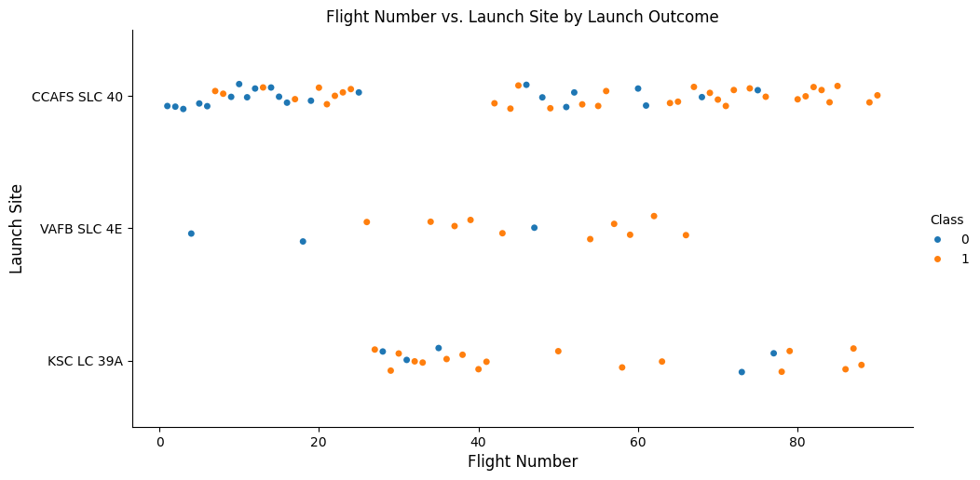
Flight Number vs. Launch Site
Plot:
Scatter (strip) plot: Flight Number (x) vs. Launch Site (y)
Color: Class (0 = failure, 1 = success)
Insight:
The plot shows how launch success varies by site and flight number.
Higher flight numbers (later missions) tend to have more successes, especially at CCAFS SLC-40 and VAFB SLC-4E.
KSC LC-39A has a high success rate across all flights.

Slide 19
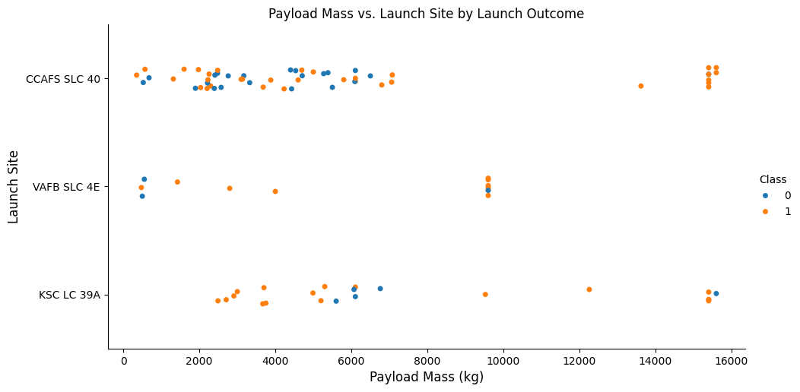
Payload vs. Launch Site
Plot:
Scatter plot: Payload Mass (x) vs. Launch Site (y)
Color: Class (landing success)
Insight:
Heavier payloads (>10,000 kg) are launched from KSC LC-39A and CCAFS SLC-40.
Success rate is high across all payload ranges, but failures cluster at lower payload masses.

Slide 20
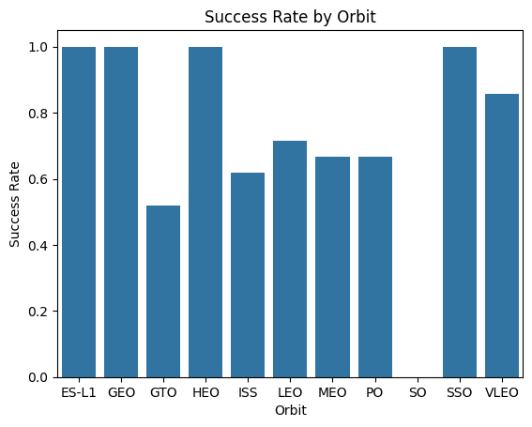
Success Rate vs. Orbit Type
Plot:
Bar chart showing success count or success rate by orbit
Insight:
Success rates vary significantly by orbit type.
ES-L1, GEO, HEO, and SSO achieved 100% success, while LEO, ISS, MEO, VLEO, and PO showed consistent performance.
GTO had the lowest success rate, indicating higher mission complexity.
This suggests orbit type is a key factor in predicting landing outcomes.

Slide 21
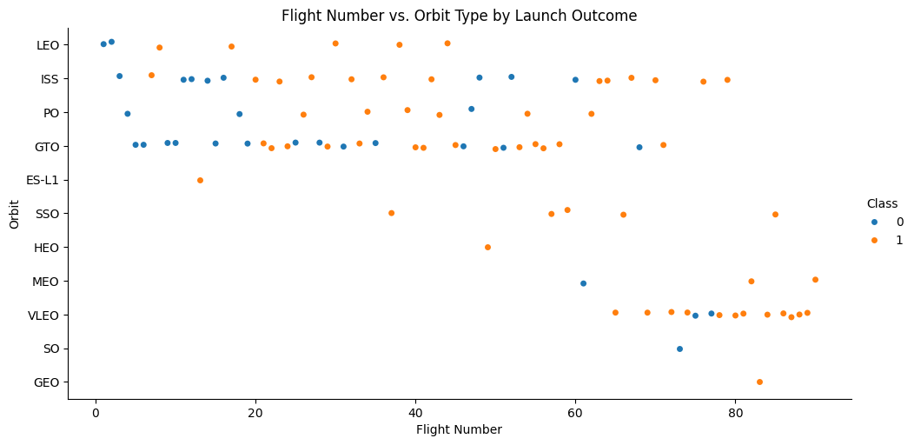
Flight Number vs. Orbit Type
Plot:
Scatter plot: Flight Number (x) vs. Orbit (y)
Color: Outcome (Class)
Insight:
Distribution of orbit types changed over time.
Some orbits became more frequent and successful in later flights.

Slide 22
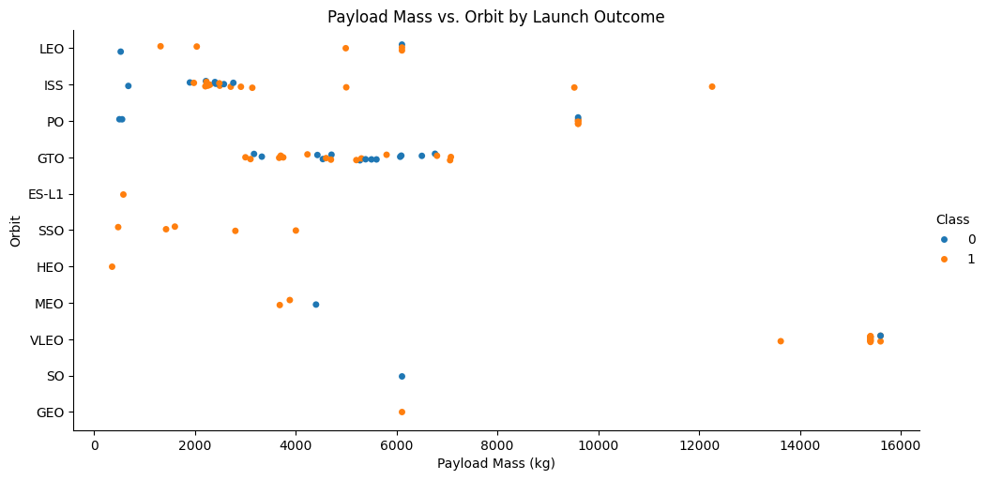
Payload vs. Orbit Type
Plot:
Scatter plot: Payload Mass (x) vs. Orbit Type (y)
Color: Success class
Insight:
Different orbits handled different payload sizes.
GTO (Geostationary Transfer Orbit) missions carry the heaviest payloads.
Failures are rare but occur across all payload ranges.
Some orbit-payload combinations were riskier.

Slide 23
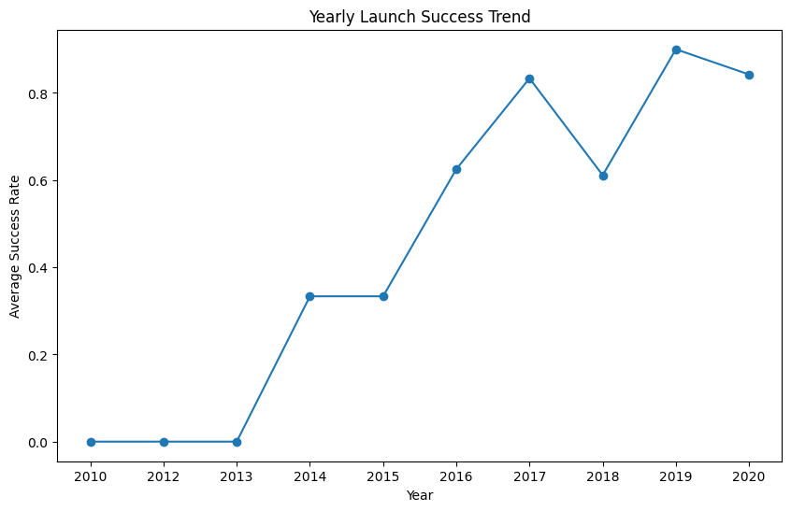
Launch Success Yearly Trend
Plot:
Line chart: Year (x) vs. Average Landing Success (y)
Insight:
Overall improvement in success rate year-over-year, peaking at ~90% after 2015.
Clear trend of reliability increasing over time.

Slide 24
All Launch Site Names
SQL Query:
SELECT DISTINCT Launch_Site FROM SPACEXTABLE;
Unique Launch Sites Found:
CCAFS LC-40
VAFB SLC-4E
KSC LC-39A
CCAFS SLC-40
Explanation:
This query identifies all unique launch sites used by SpaceX. The results show 4 unique launch sites used by SpaceX, including 2 at Cape Canaveral (CCAFS) and one each at Vandenberg and Kennedy Space Center.

Slide 25
Launch Site Names Begin with 'CCA'
SQL Query:
SELECT * FROM SPACEXTABLE WHERE Launch_Site LIKE 'CCA%' LIMIT 5;
Result:
Displays 5 early missions from Cape Canaveral (CCAFS) launch sites.
Explanation:
Filters for launch sites starting with 'CCA' (Cape Canaveral), showing the first 5 records including dates, payloads, and outcomes.

Slide 26
Total Payload Mass
SQL Query:
SELECT SUM(PAYLOAD_MASS__KG_) AS Total_Payload_Mass FROM SPACEXTABLE WHERE Customer LIKE '%NASA (CRS)%’;
Total Payload:
48,213 kg
Explanation:
Calculates the combined payload mass delivered for NASA's Commercial Resupply Services missions.

Slide 27
Average Payload Mass by F9 v1.1
SQL Query:
SELECT AVG(PAYLOAD_MASS__KG_) AS Average_Payload_Mass FROM SPACEXTABLE WHERE Booster_Version = 'F9 v1.1’;
Average Payload:
~2,928.4 kg
Explanation:
Shows the typical payload capacity for SpaceX's Falcon 9 v1.1 booster variant.

Slide 28
First Successful Ground Landing Date
SQL Query:
SELECT MIN(Date) AS First_Success FROM SPACEXTABLE WHERE Landing_Outcome = 'Success (ground pad)’;
Date:
2015-12-22
Explanation:
Marks the historic first time SpaceX successfully landed a booster vertically on land.

Slide 29
Successful Drone Ship Landing with Payload between 4000 and 6000
SQL Query:
SELECT Booster_Version FROM SPACEXTABLE WHERE Landing_Outcome = 'Success (drone ship)’ AND PAYLOAD_MASS__KG_ BETWEEN 4000 AND 6000;
Boosters:
F9 FT B1022
F9 FT B1026
F9 FT B1021.2
F9 FT B1031.2
Explanation:
Lists boosters that achieved drone ship landings with medium-weight payloads (4-6 metric tons).

Slide 30
Total Number of Successful and Failure Mission Outcomes
SQL Query:
SELECT Mission_Outcome, COUNT(*) AS Total FROM SPACEXTABLE GROUP BY Mission_Outcome;
Explanation:
Demonstrates SpaceX's high success rate.
Mission_Outcome | Total
Failure (in flight) | 1
Success | 98
Success | 1
Success (payload status unclear) | 1

Slide 31
Boosters Carried Maximum Payload
SQL Query:
SELECT Booster_Version, PAYLOAD_MASS__KG_ FROM SPACEXTABLE WHERE PAYLOAD_MASS__KG_ = (SELECT MAX(PAYLOAD_MASS__KG_) FROM SPACEXTABLE);
Result:
12 records of F9 B5 boosters carrying 15,600 kg
Explanation:
Identifies the most powerful booster configuration and its payload capacity.

Slide 32
2015 Launch Records
SQL Query: SELECT substr(Date,6,2) AS Month, Landing_Outcome, Booster_Version, Launch_Site FROM SPACEXTABLE WHERE substr(Date,0,5)='2015' AND Landing_Outcome = 'Failure (drone ship)’;
Explanation:
Shows SpaceX's early challenges with drone ship landings in 2015 before perfecting the technology.
Month | Landing_Outcome | Booster_Version | Launch_Site
01 | Failure (drone ship) | F9 v1.1 B1012 | CCAFS LC-40
04 | Failure (drone ship) | F9 v1.1 B1015 | CCAFS LC-40

Slide 33
Rank Landing Outcomes Between 2010-06-04 and 2017-03-20
SQL Query:
SELECT Landing_Outcome, COUNT(*) AS Count FROM SPACEXTABLE WHERE Date BETWEEN '2010-06-04' AND '2017-03-20’ GROUP BY Landing_Outcome ORDER BY Count DESC;
Explanation:
Tracks the evolution of landing attempts during SpaceX's experimental phase.
Landing_Outcome | Outcome_Count
No attempt | 10
Success (drone ship) | 5
Failure (drone ship) | 5
Success (ground pad) | 3
Controlled (ocean) | 3
Uncontrolled (ocean) | 2
Failure (parachute) | 2
Precluded (drone ship) | 1

Slide 34

Section 3

Slide 35
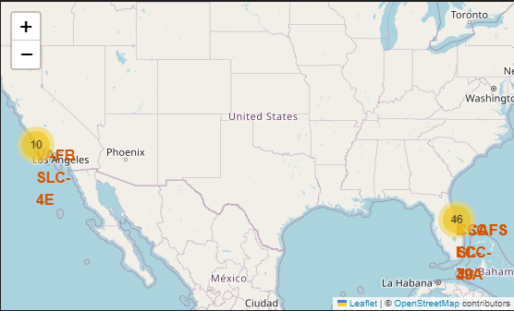
Global Distribution of SpaceX Launch Sites
Description:
This map displays the locations of all four SpaceX launch sites:
CCAFS LC-40 and CCAFS SLC-40 in Florida (USA).
KSC LC-39A in Florida (USA).
VAFB SLC-4E in California (USA).
Key Findings:
All launch sites are located near coastlines, facilitating safe launch trajectories over water.
Sites are clustered in low-latitude regions (close to the Equator), which is optimal for achieving orbital velocity efficiently.

Slide 36
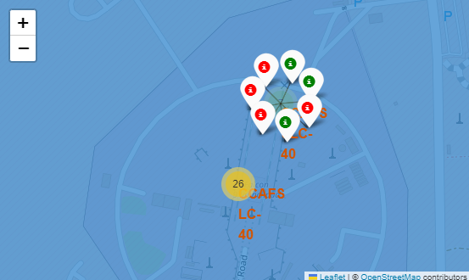
Launch Outcomes Visualized by Color Markers
Description:
Green markers: Successful launches (class=1).
Red markers: Failed launches (class=0).
Marker clusters simplify visualization for high-density launch records (e.g., CCAFS SLC-40).
Key Findings:
KSC LC-39A shows a high success rate (mostly green markers).
CCAFS SLC-40 has a mix of outcomes, indicating variability in launch success.
Proximity to support infrastructure (e.g., NASA facilities) may correlate with higher success rates.

Slide 37
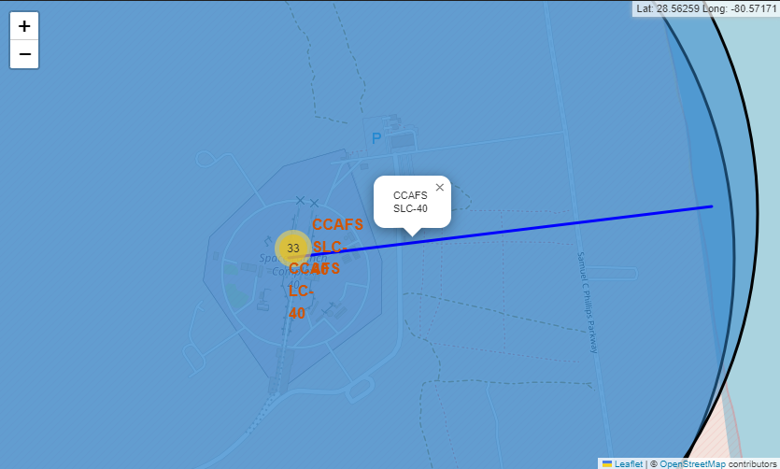
Launch Site Proximity to Coast
Description:
This screenshot shows a launch site and its distance from coastline. Using polylines, we calculate and display distances to nearby locations, such as a highway and railway
Key Findings:
Launch sites are strategically placed near logistical infrastructure while maintaining safe distances from populated areas.
Coastal proximity minimizes risks to human settlements during failures.

Slide 38

Section 4

Slide 39
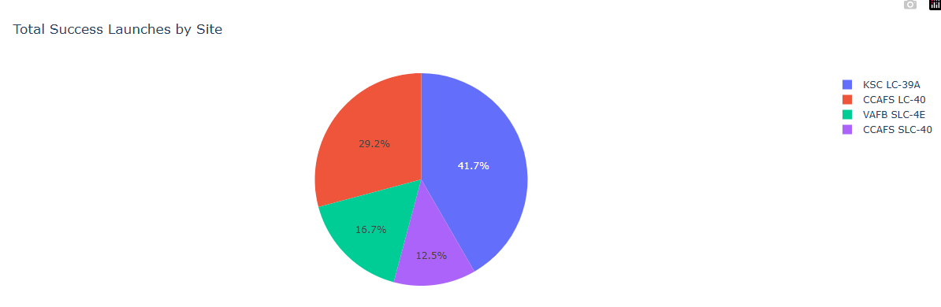
Launch Success Count by Site
Explanation:
This pie chart displays the total number of successful launches across all SpaceX launch sites.
Key findings:
KSC LC-39A has the highest number of successes (41.7%), followed by CCAFS LC-40.
This highlights site-level performance and allows us to compare reliability among different launch locations.
39

Slide 40
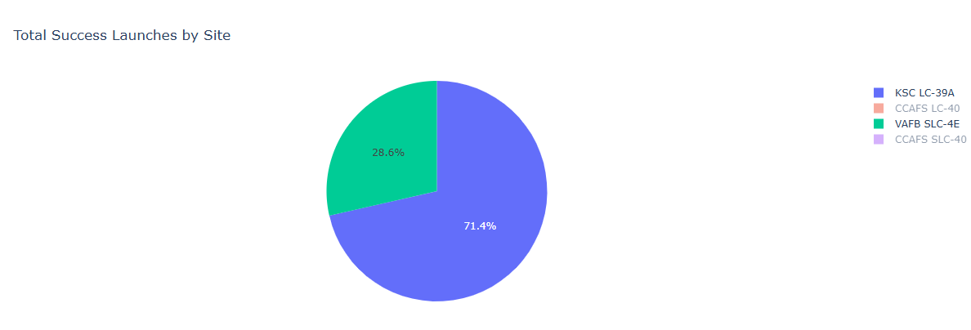
Highest Launch Success Ratio Site
Explanation:
This chart zooms in on the launch site with the highest success rate — KSC LC-39A, which has a 71.4% success rate, in contrast to VAFB SLC-4E.
Key findings:
This site consistently demonstrates better launch outcomes.
Ideal location to prioritize for future missions due to reliability.
40

Slide 41
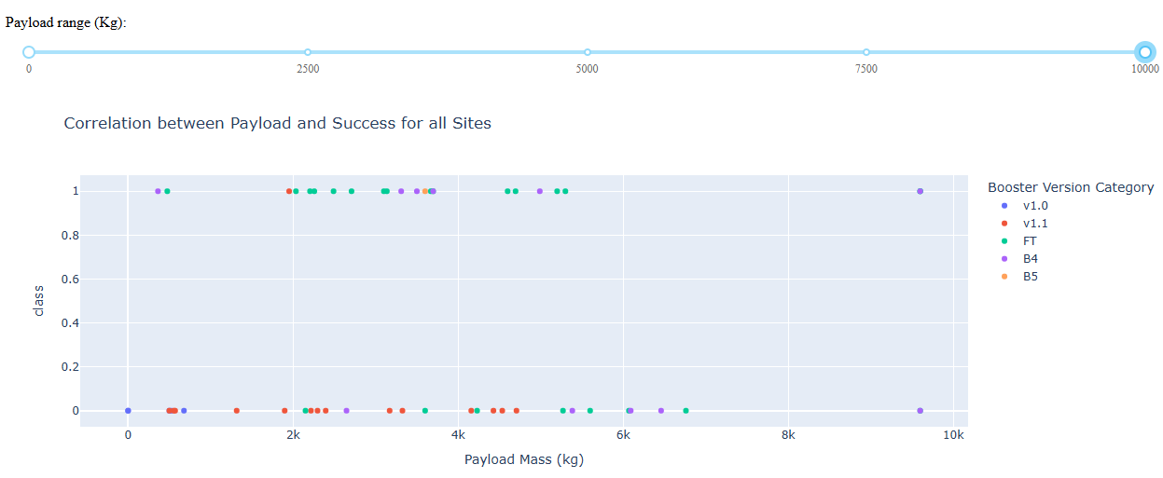
Payload vs Launch Outcome Scatter Plot
Explanation:
This scatter plot visualizes the correlation between payload mass and launch outcome across all sites.
Key findings:
Successful launches (class = 1) are spread across payload ranges.
Booster versions like B5 show higher success rates for heavy payloads (4000–6000 kg).
The interactive slider allows users to isolate trends for specific mass ranges.
41

Slide 42

Section 5

Slide 43
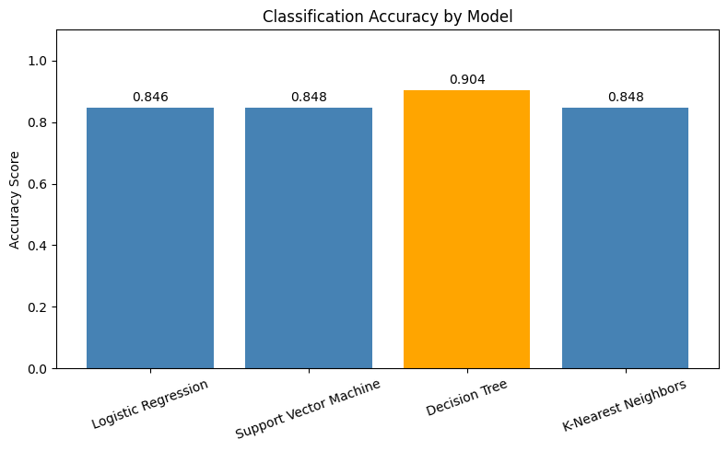
Classification Accuracy
Description:
We compared Logistic Regression, Support Vector Machine (SVM), Decision Tree and K-Nearest Neighbors Classifier using GridSearchCV.
The best performing model was Decision Tree with 90.4% accuracy.
Insight:
The Decision Tree model outperformed all others in accuracy, making it the most suitable for our binary classification task involving SpaceX launch outcome prediction.

Slide 44
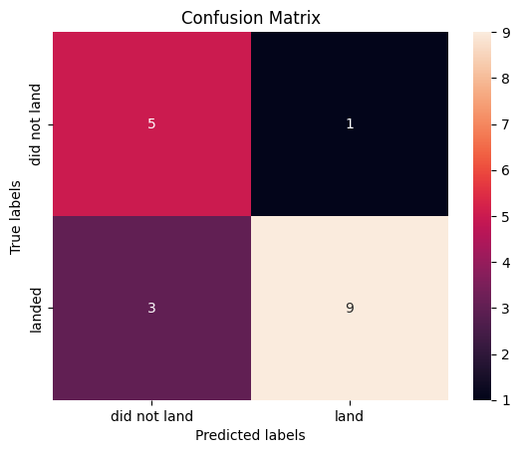
Confusion Matrix
Explanation:
The model correctly classified: → 9 successful landings → 5 failed landings → 1 launch was incorrectly predicted as success → 3 successful landings were missed by the model
Insight:
The model Decision Tree shows strong precision (90.4%) on predicting landings and a balanced performance across both classes, making it suitable for this binary classification task.

Slide 45
Conclusions
This project successfully predicted Falcon 9 first stage landing outcomes with high accuracy, validating the potential of machine learning in aerospace applications.
It demonstrated the full data science workflow — from API and web scraping to feature engineering, analysis, visualization, and model development.
Key patterns in mission success were uncovered through SQL queries and exploratory visualizations, offering valuable operational insights.
Interactive tools such as Folium maps and Plotly Dash dashboards made complex data more accessible and actionable.
Overall, this project highlights how data-driven approaches can support strategic decision-making and innovation in space launch operations.

Slide 46
Appendix
GitHub Repository:
https://github.com/paulohenriquecunha/FinalProjectDataScience
Includes all notebooks, scripts, and visualizations
Datasets Used:
SpaceX Public API
Wikipedia (web-scraped Falcon 9 & Falcon Heavy launch data)
Python Libraries:
Pandas, Seaborn, Matplotlib, Folium, Plotly Dash, Scikit-learn, SQLAlchemy
Tools & Platforms:
JupyterLab, Google Colab, GitHub, Visual Studio Code

Slide 47


